Slide 1
The Basics: Dealing with Files (Mini-task)
Create two files
$ touch foo.txt $ touch bar.txt
Add text into the files and print it
echo "Cat" > foo.txt
echo "Dog" > bar.txt
cat foo.txt bar.txt (concatenates the output)
Output:
Cat
Dog

Slide 2
The Basics: History
<up arrow>: previous command
<tab>: auto-complete
!!: replace with previous command
history : gives you all the commands typed previously
!<string>: executes last command which has <string>

Slide 3
The Basics: Redirection
> file: write stdout to a file
>> file: append stdout to a file
< file: use contents of a file as stdin

Slide 4
Task 1 (Hint: use “wc” command)
Create 2 .txt files and add multiple lines in each one of them
Get the line count for each of these files
Cat abc.txt | wc -l

Slide 5
The Basics: find
-type: type of a file (e.g,, directory, symbolic link)
-perm: permission of a file
-name: name of a file
-ls: list current file

Slide 6
find contd…
?: matches any single character in a filename
*: matches zero or more characters in a filename
[]: matches any one of the characters between the brackets. Use ‘-’ to separate a range of consecutive characters.
Examples:
find . -name my*
find . -name my* -type f
find / -type f -name myfile

Slide 7
wh commands
whatis <command>: returns Name section of man page
whereis <command>: locates the binary, source, and manual page files for a command
which <command>: locates only the binary

Slide 8
diff command
A file comparison utility that outputs the differences between two files.
Usage:
diff file1 file2

Slide 9
wget command
A computer program that retrieves content from web servers
Usage
wget <URL>

Slide 10
The Basics: Look These Up
head
tail
du
top
ps
kill
diff
cmp
echo
find
wc
sort
ping 8.8.8.8
diff
wget <url>

Slide 11
The Basics: Changing File Attributes
ln : creates a link
Hard links : Point to physical Data
Additional name for an existing file
ln file1 hlink1
Soft Links/ Symbolic Links (-s): Point to file
ln –s <source file> <my file>
touch: update access & modification time to current time
touch filename
touch –t 01311759.30 filename
Change filename’s access & modification time to (January day 31 time 17:59:30)

Slide 12
Emacs editor (We will be using Emacs for this course)
Almost like a Windows text editor, but much more powerful
Run emacs on the linux server
C-h r (manual) and C-h t (tutorial)
All emacs commands start with ‘C’ or ‘M’
‘C’ = ctrl; ‘M’ = alt (windows)/ option (Mac)
Start emacs
emacs <filename>
Exit emacs
C-x C-c

Slide 13
Basic emacs editing
Insert text by simply typing it
Undo by typing C-x u
Save changes by typing C-x C-s
Copy, cut, paste
C-space (starts selecting region)
M-w (copy a region)
C-w (cuts a region)
C-k (kill a line)
C-y (yank/paste)

Slide 14
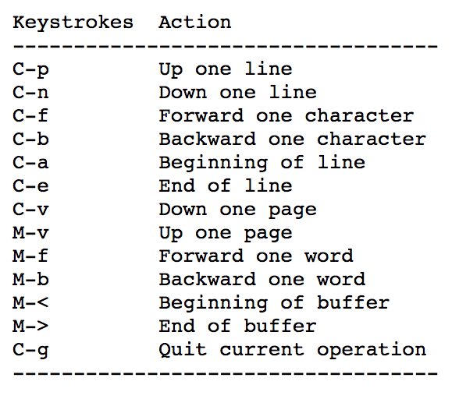
Moving around

Slide 15
More emacs commands
Search – C-s
Replace – M-%
Accessing menu – F10
Switch buffer – C-x b
Switch current window – C-x o
Kill the current window – C-x 0 (zero)
Help – C-h

Slide 16
Directory edit (dired) (C-x d)
Creates an Emacs buffer containing list of directory contents
Allows you to operate on files
Allows you to navigate filesystem
+ - new directory, C-x C-f new file in directory, g - refresh dired buffer
! - run shell command
https://www.gnu.org/software/emacs/refcards/pdf/dired-ref.pdf

Slide 17
Task 2
Create a cpp file (print “hello”) using emacs
Run the file
Edit the file (print “hello again”) using emacs and save it as a new file
Run the new file
Solution:
C-x s, C-x C-w

Slide 18
Cpp program
#include<iostream>
using namespace std;
int main(){
cout<< “Hello”;
return 0;
}
Compiling instr:
g++ -o filename filename.cpp
./filename

Slide 19
Task 3
Create 2 txt files (insert some lines) using emacs
Find the difference between both of them using a linux command
Solution:
diff file1 file2

Slide 20
Tasks
Create a file using emacs. Try the Cut/Copy/Paste commands.
Write a command to list all files as well as the hidden files in your home directory.
Remove a non-empty directory.
Assign the value 10 to a variable x, 15 to a variable y; Compute and display their addition in the shell. Do not use any editor!
Echo $(( ….. ))
Man expr
Create a directory ‘test’ and ‘subtest’ inside test (in the home directory) without using mkdir twice. (mkdir –p test/subtest)
Create empty files ans.txt, ans.html, assign.txt, assign.html
Find all directories and subdirectories in your home directory
find . –type d
Find all files in the test directory starting with ‘a’ (find ./test –type f –name ‘a*’)
Find all text files inside test directory
find ./test –type f –name ‘*.txt’
Find all html files inside test directory
Find ./test –type f –name ‘*.html’
Delete test directory from the home directory (rm –rf <dirname>)
Notes:
echo $(($a + $b))

